Slide 1
The Best Words
Data mining Reddit to capture political moods

Slide 3
Reddit as the internet’s id
Notes:
Mostly memes?

Slide 4

Reddit as a political looking glass
Notes:
Super active political community, good opportunity to mine out data

Slide 5
This project:
Analyse the 1000 most “top” and “controversial” threads and comment trees on /r/ politics for previous 12 months
Methods
Python package PRAW, a wrapper for Reddit’s API + Jupyter notebook
Data cleaning, analysis and sentiment mapping using R
tidyr, dpyr, stringr, purrr, tidytext
Microsoft Cognitive Services Azure Text Analytics API
Data visualisation
ggplot2, plotly

Slide 6
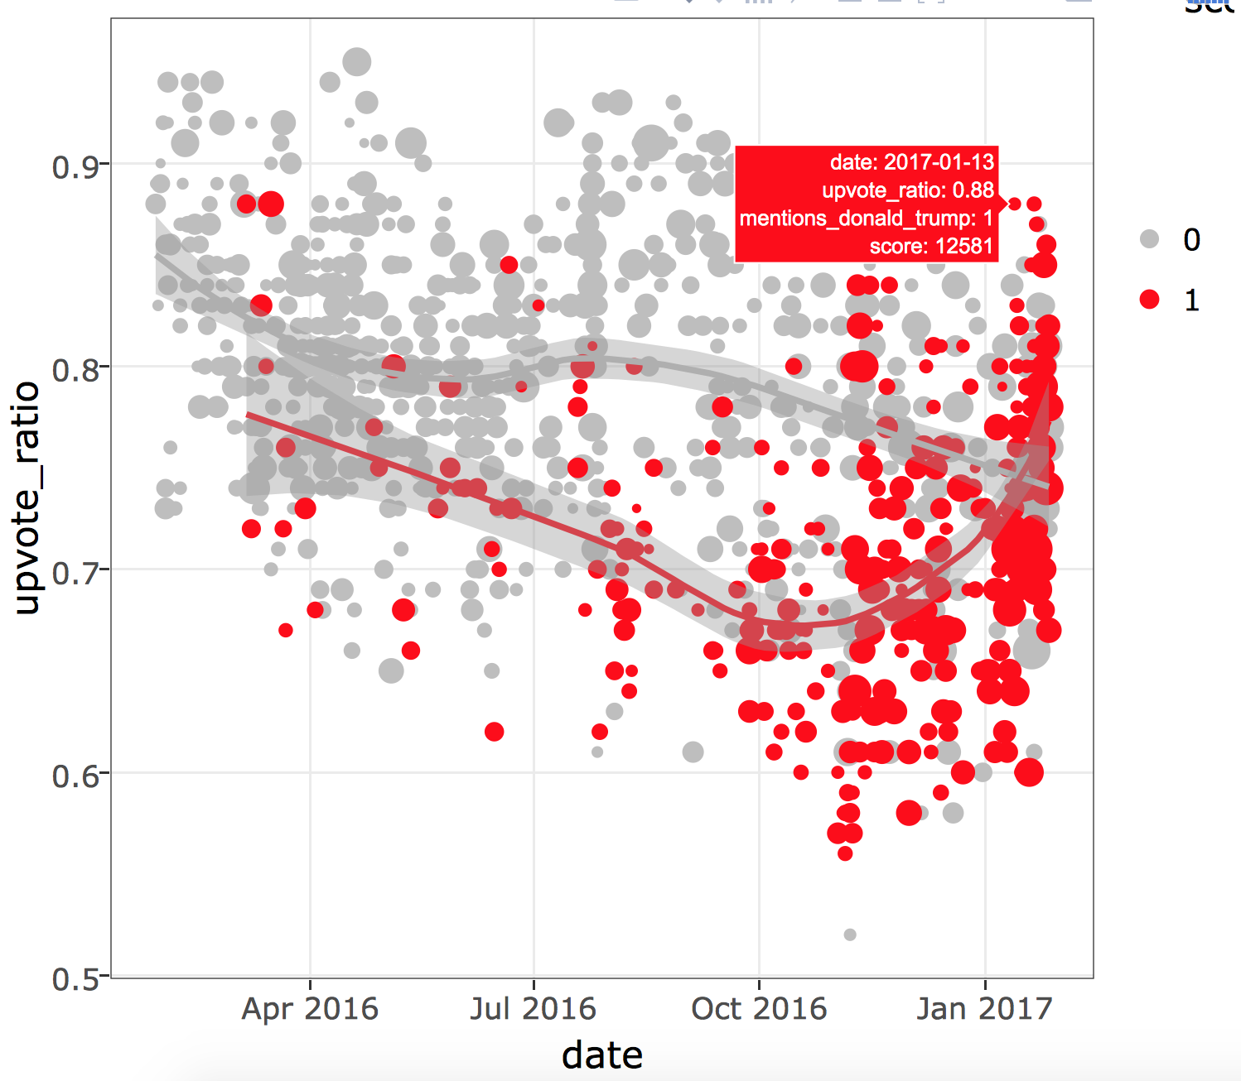
Upvote For Trump 2016
The top 1000 posts in /r/politics in last year, have gradually gotten more controversial (lower upvote ratio) over the past 12 months
Tons more post titles mention Trump (red dots) after the election (too late!)
Trump (red line) started to be viewed much more positively starting in October! Bad omen.

Slide 7
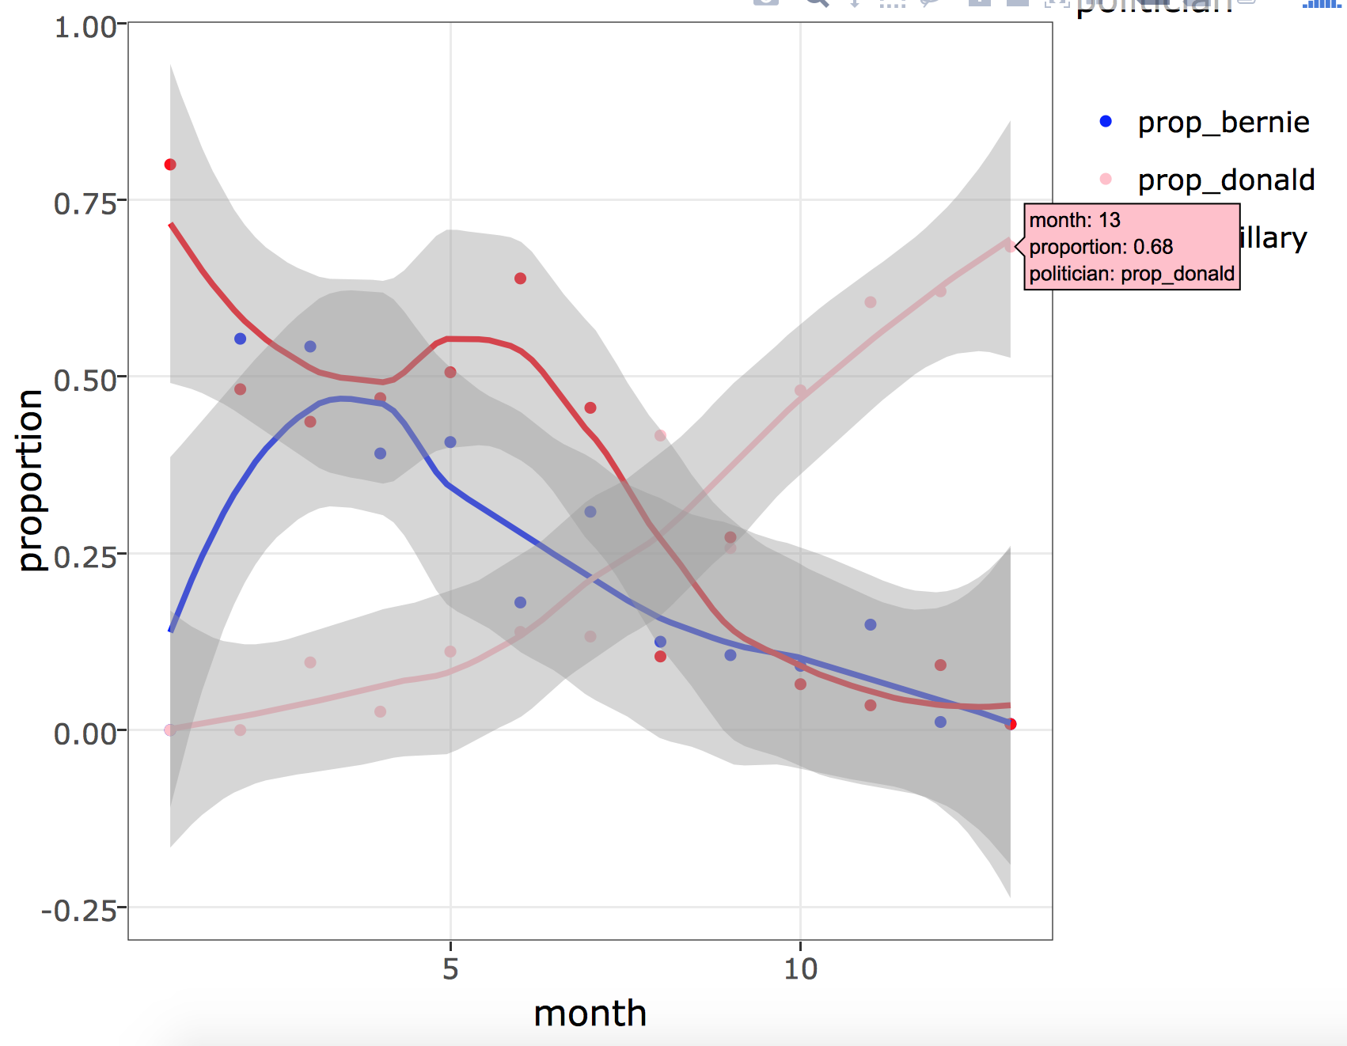
The eclipse
Proportion of top submissions containing “Trump” or “Donald” over the last 12 months. It’s now (month=13) up to 69%!
Bernie and Hillary down to ~ 0%.
Trump publicity really overtook Sanders/Clinton in late march (month of 0 is January 2016)
Hillary has always enjoyed higher coverage than Bernie.

Slide 8
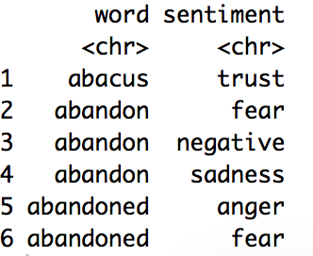
Trends in hate, disgust, fear, etc. towards Trump, Clinton, Sanders
Titles of submissions
Text of the top comment per submission
…
N=13901

Slide 9
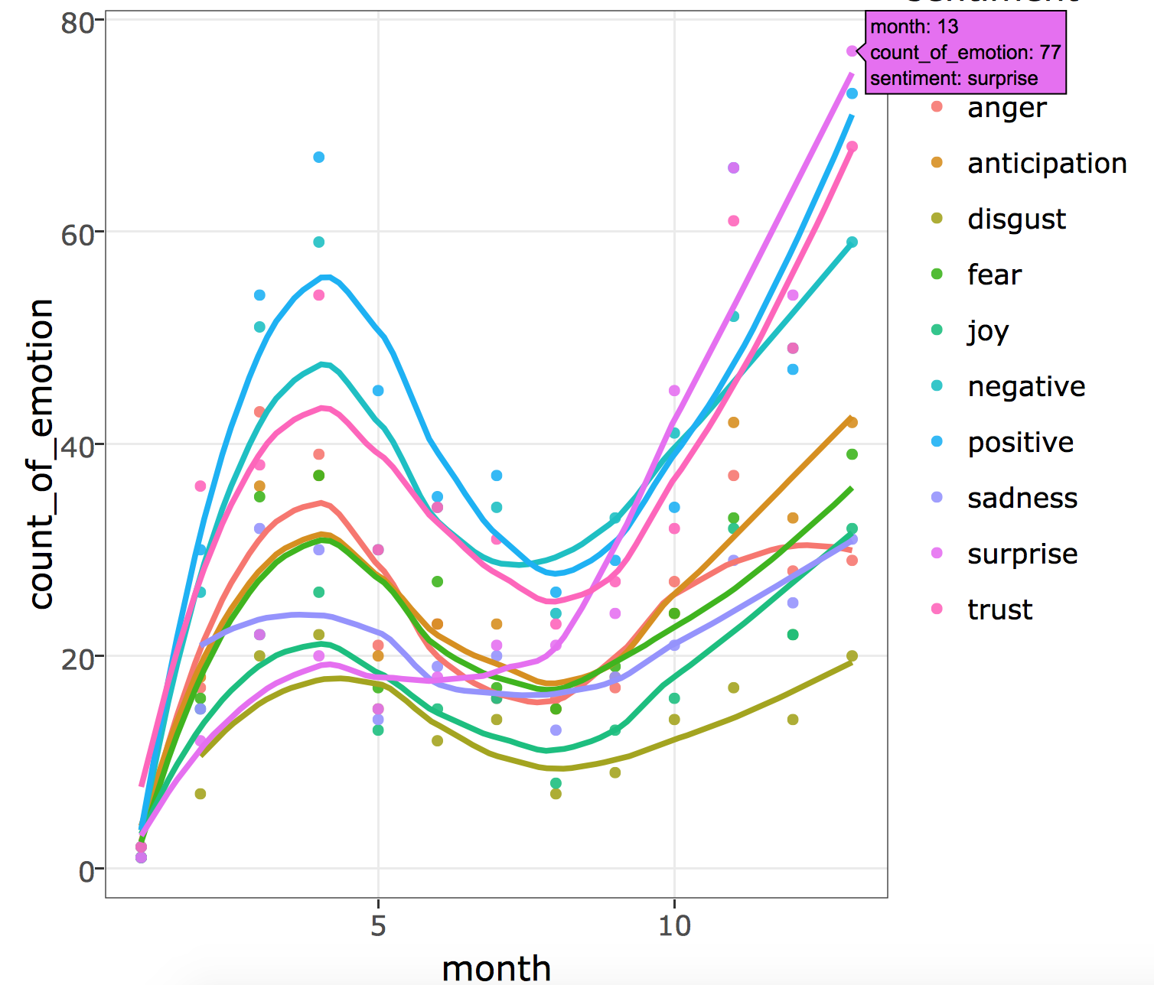
Emotions about politics in general
Big correlations because raw counts, need to scale..

Slide 10
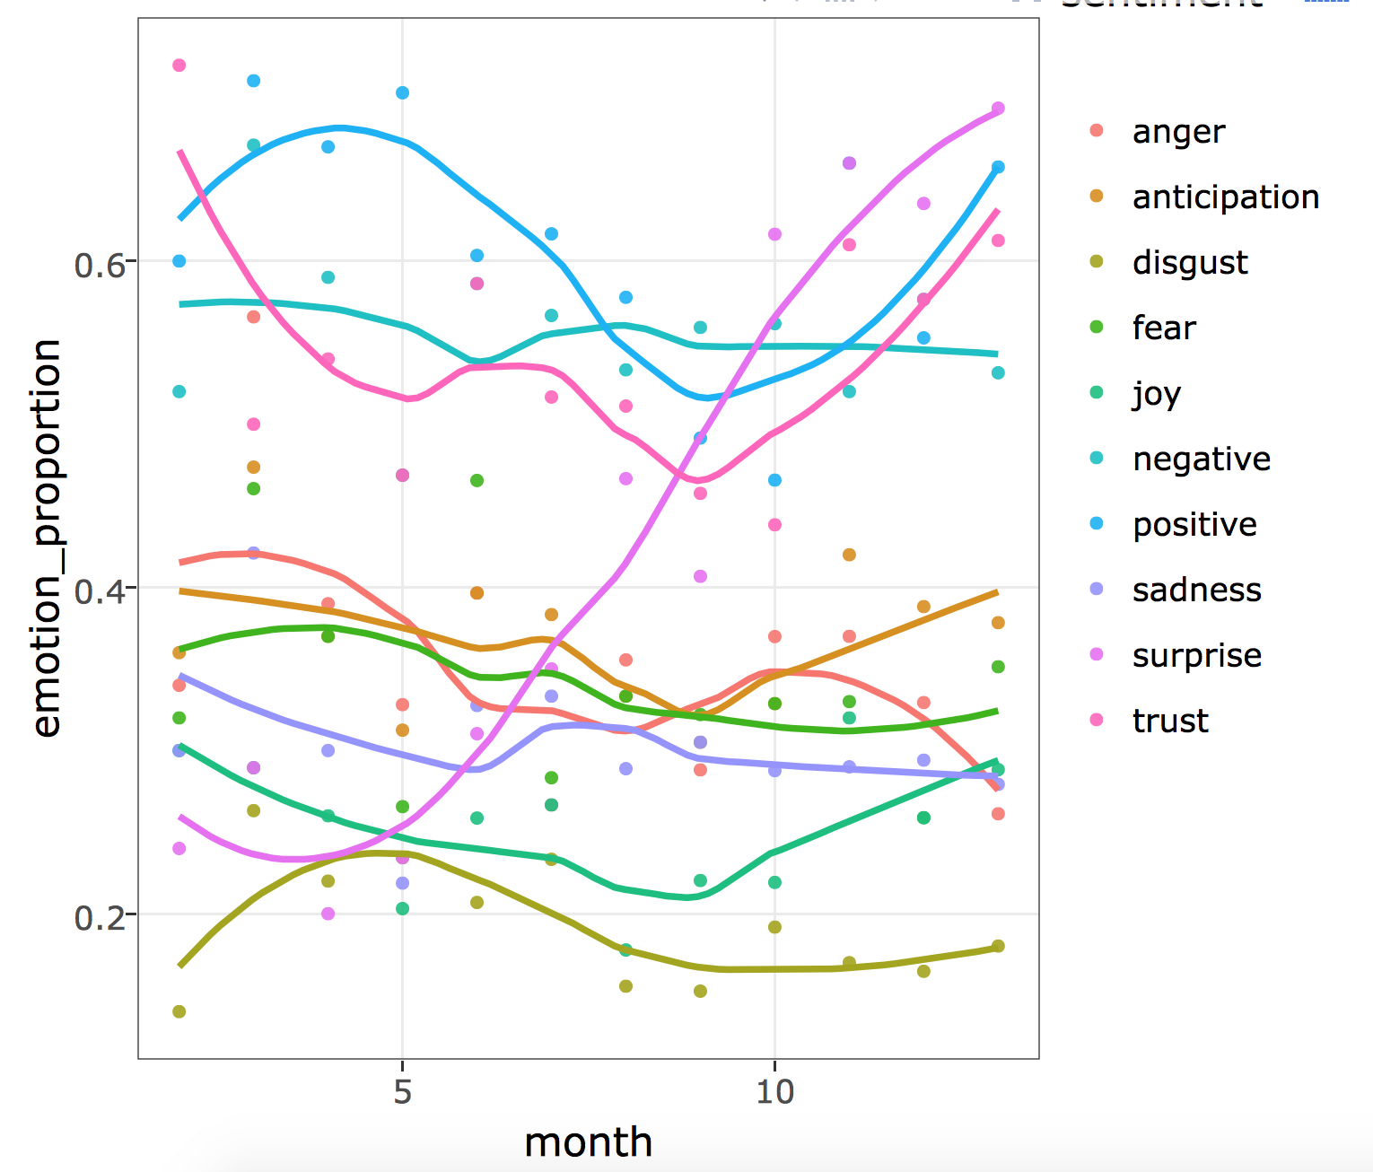
“Surprise” is going up and up and up!
Trust hit the lowest point at the month before the election
Post-election, we are seeing a lot of fear (green)!
Weirdly, post-election, trust and positivity are also going up?
The year started off pretty positive and then nosedived, recovering now

Slide 11
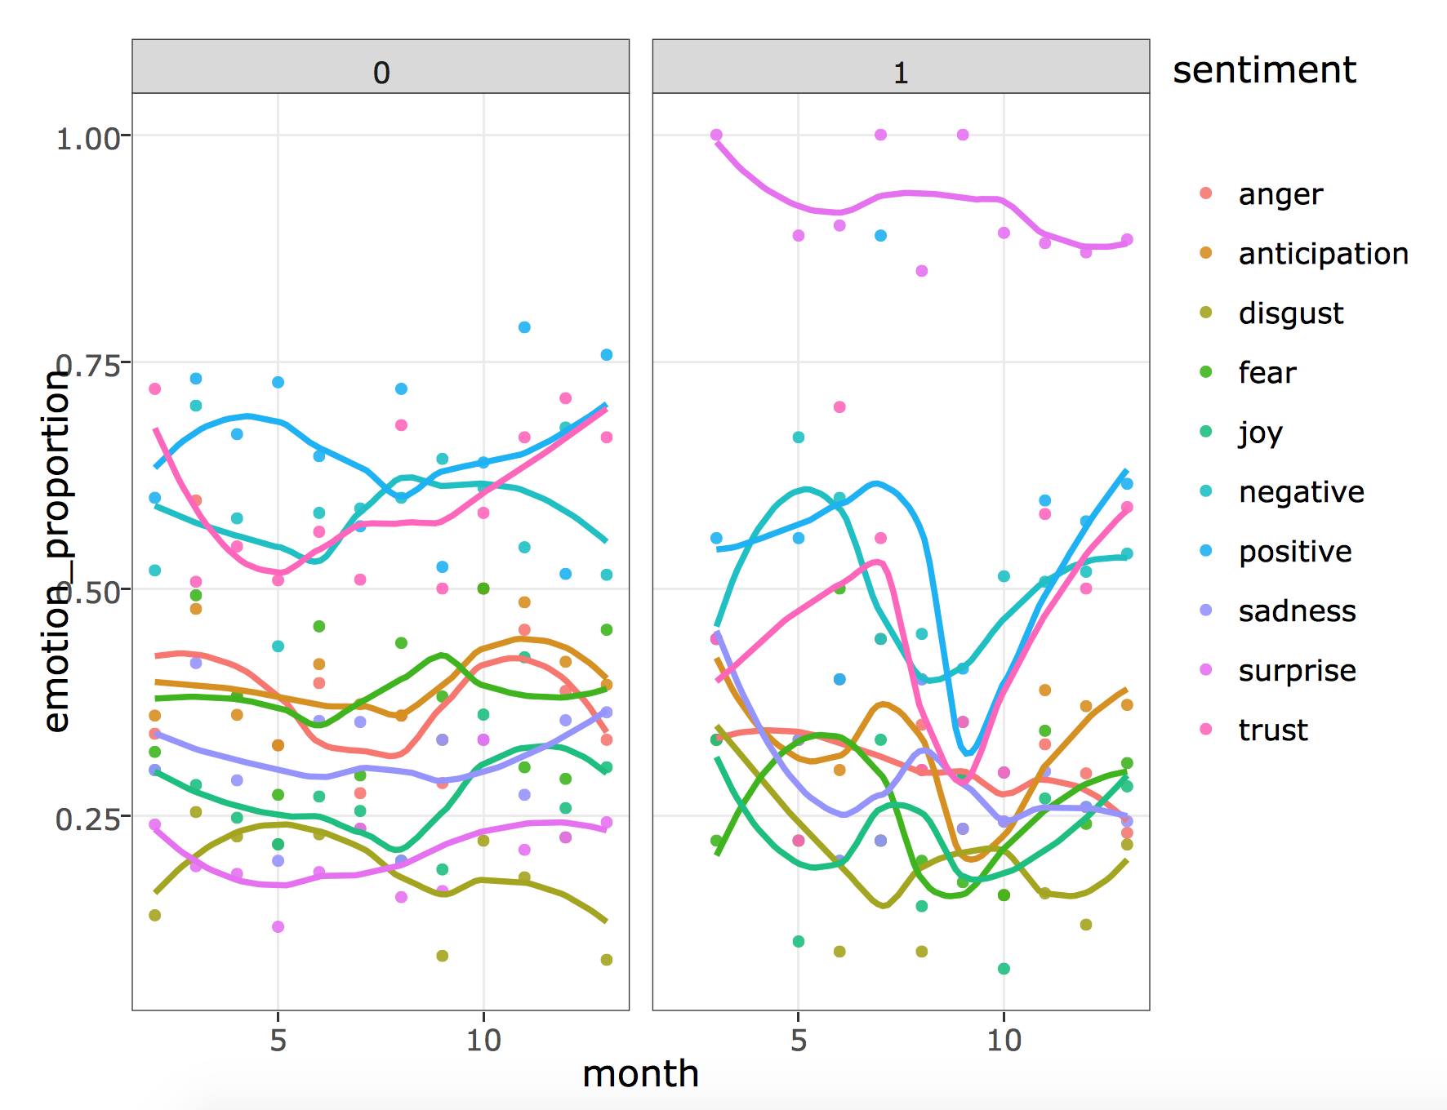
Emotional swings are due to The Donald
Left panel (0) is posts not mentioning Donald, right panel mentions Donald
The level of surprise is much much higher in posts related to Trump
The huge dips in trust, joy, happiness pre-election we saw before are largely due to Trump!

Slide 12
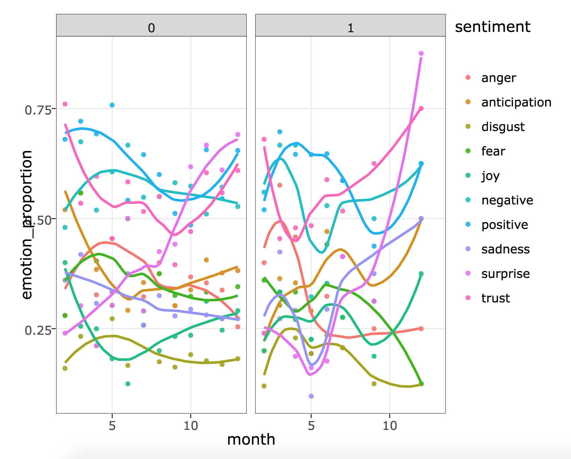
Compared to Hillary..
Posts about Hillary Clinton (facet with ‘1’) don’t have such strong trends, mostly just follow the background levels of emotions about politics
Main trend we do see here – anger/sadness/fear peaked right around the time that Donald was gaining lots of popularity (see plots 2)… related to the scandals, probably.

Slide 13
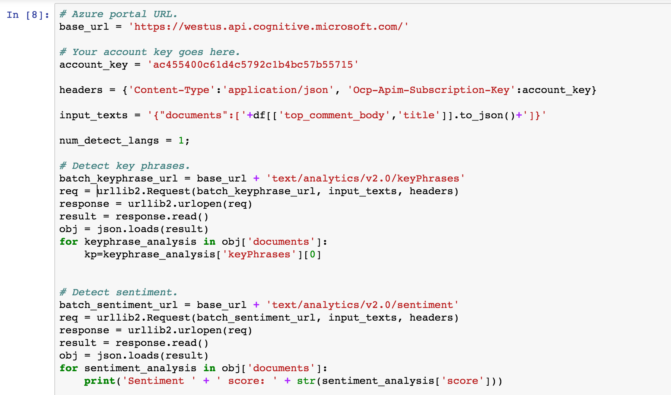
Topic and sentiment detection with Azure
Convert pandas dataframe containing text of interest into a .json dictionary and pass as result to sentiment mapper as a url using urllib2
Unfortunately I couldn’t get this to work at scale. HTTP timeouts, too many requests sent?
Still interesting for a few cases.
Would be better if it could map multiple emotions instead of positive/negative.

Slide 14
Future work

Slide 15
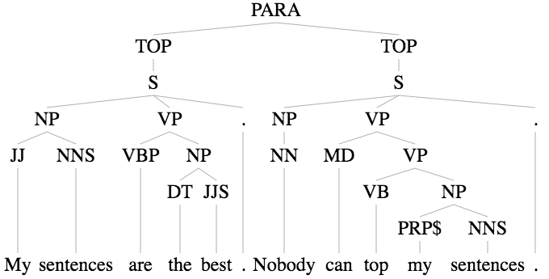
Microsoft syntactic structure detection… soon to be foiled by Trump’s sentences?

Slide 16
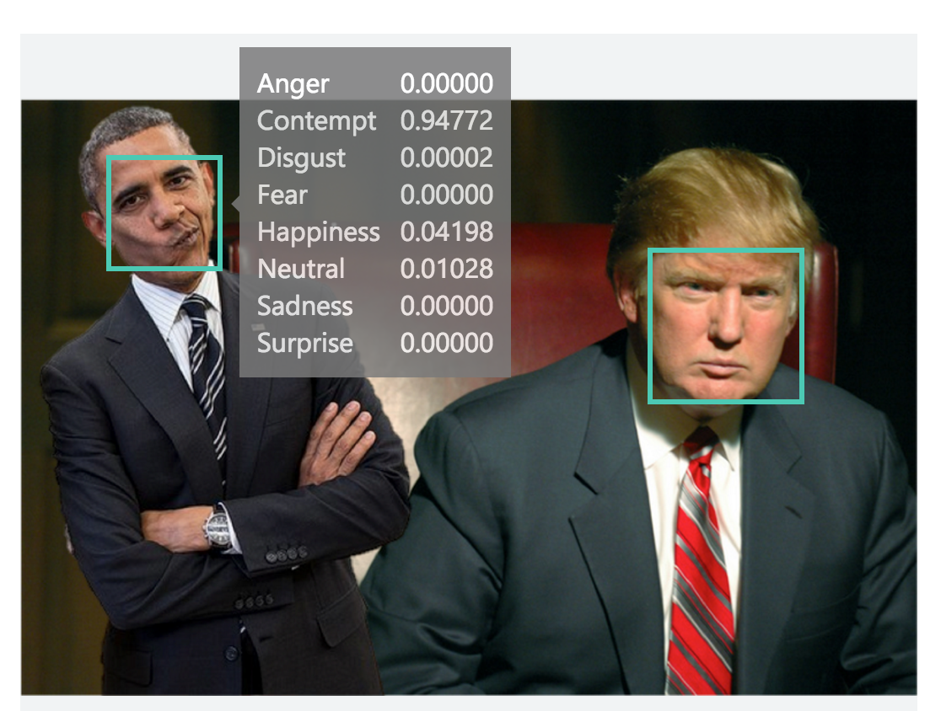

Slide 17
Appendix (Methods + Code)

Slide 18
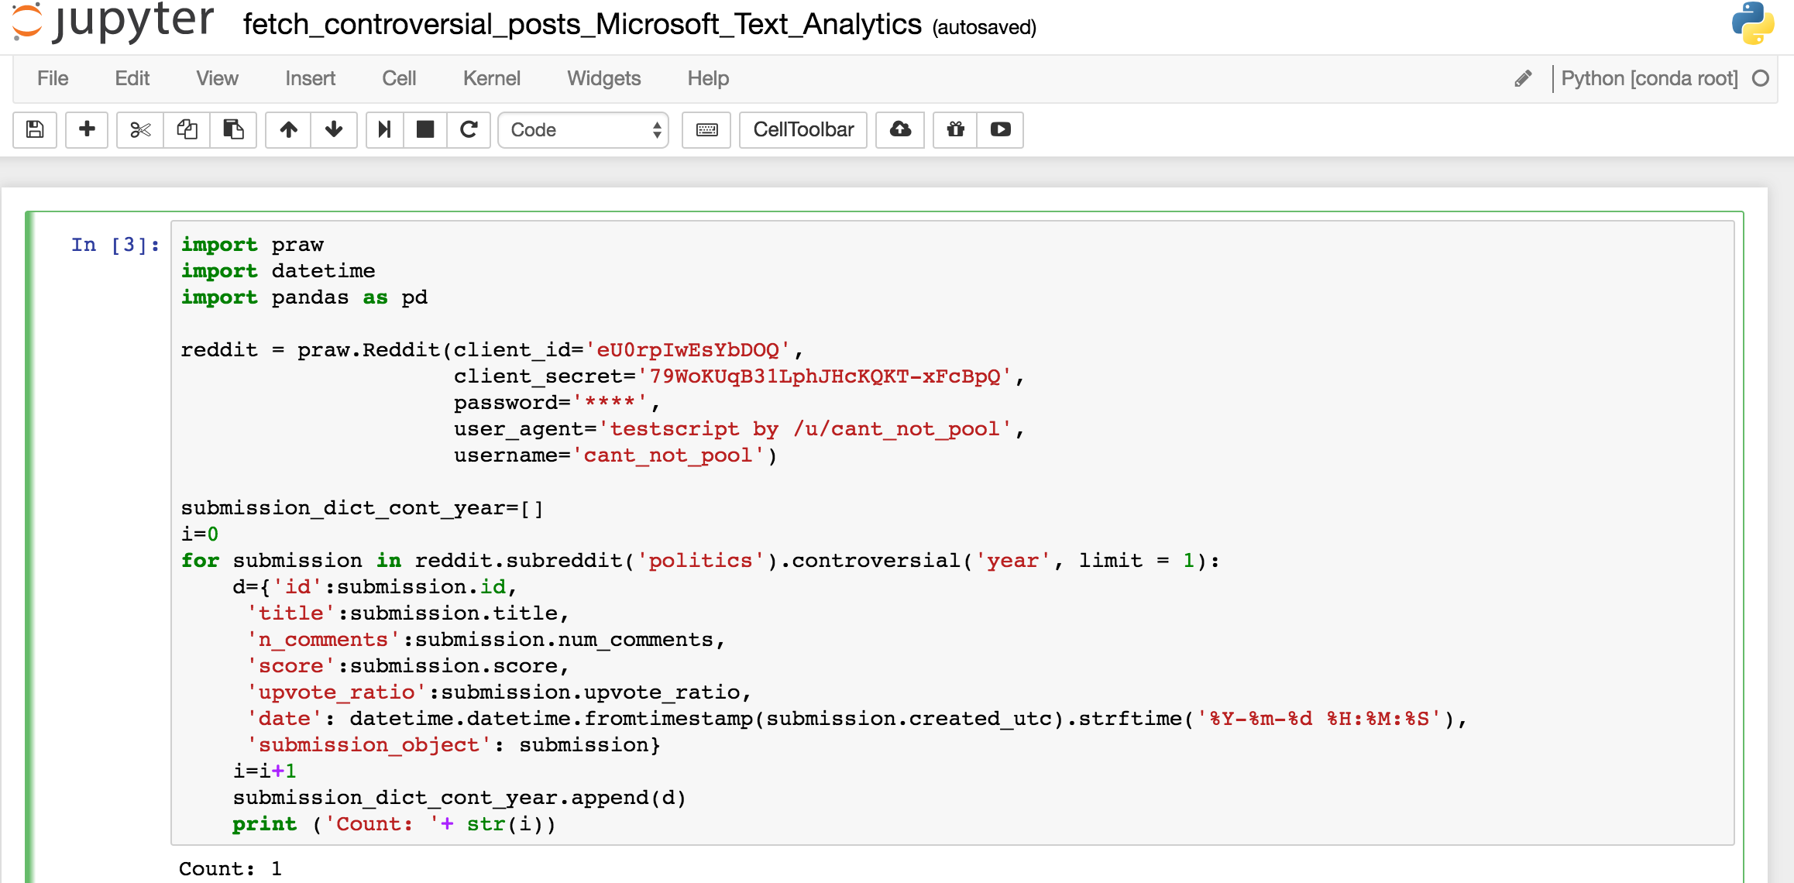
Mining reddit data
Used jupyter notebook + python to mine reddit data for /r/politics
Can also collect the data live
Can specify if you want “top”, or “controversial”
Known issue – can’t get more than 1000 posts
Rough/quick code at https://github.com/nslatysheva/hack_cambridge_2017

Slide 19
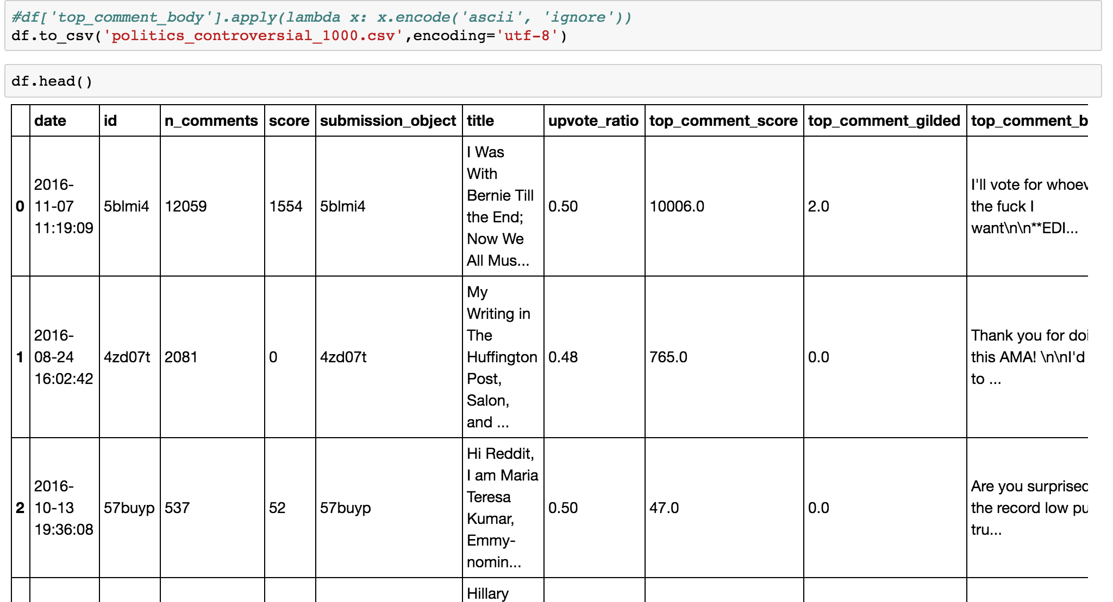
Output is something like this
Data dictionary then converted to dataframe and exported into R
Just because I am most comfortable in doing analysis with R

Slide 20
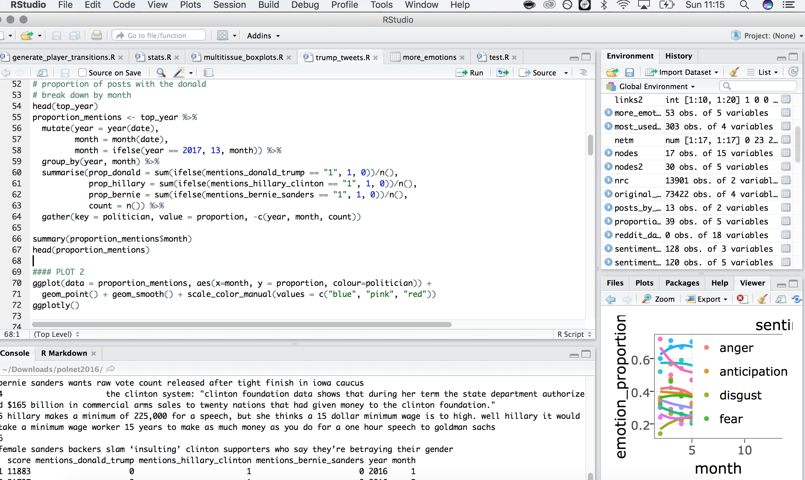
R analysis took a while
Using Rstudio for R scripting
Tons of data manipulation to do for every plot basically
Visualisation with ggplot2, interactivity with ggplotly

Slide 21
Topic and sentiment detection with Azure
Convert pandas dataframe containing text of interest into a .json dictionary and pass as result to sentiment mapper as a url using urllib2
Unfortunately I couldn’t get this to work at scale. HTTP timeouts, too many requests sent?
Still interesting for a few cases.
Would be better if it could map multiple emotions instead of positive/negative.

Slide 22
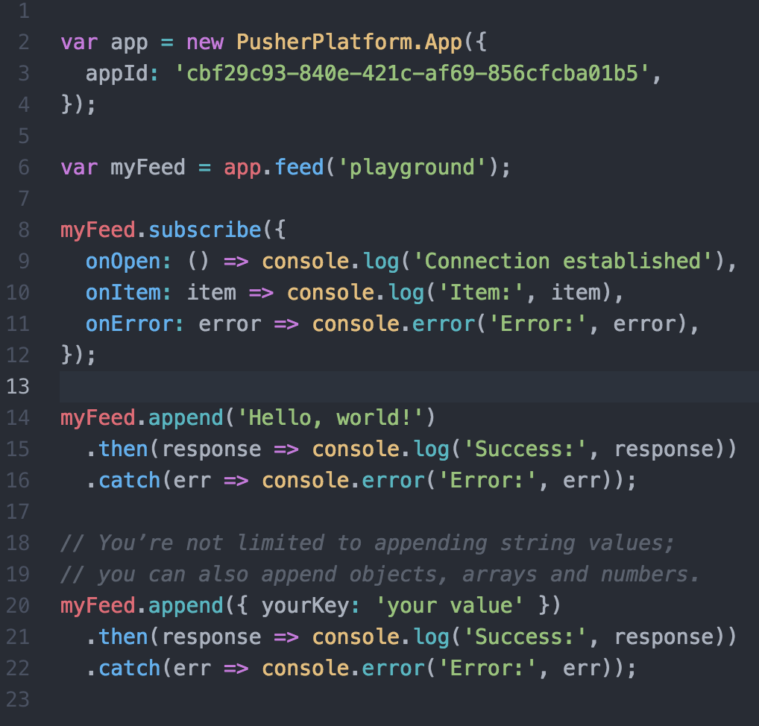
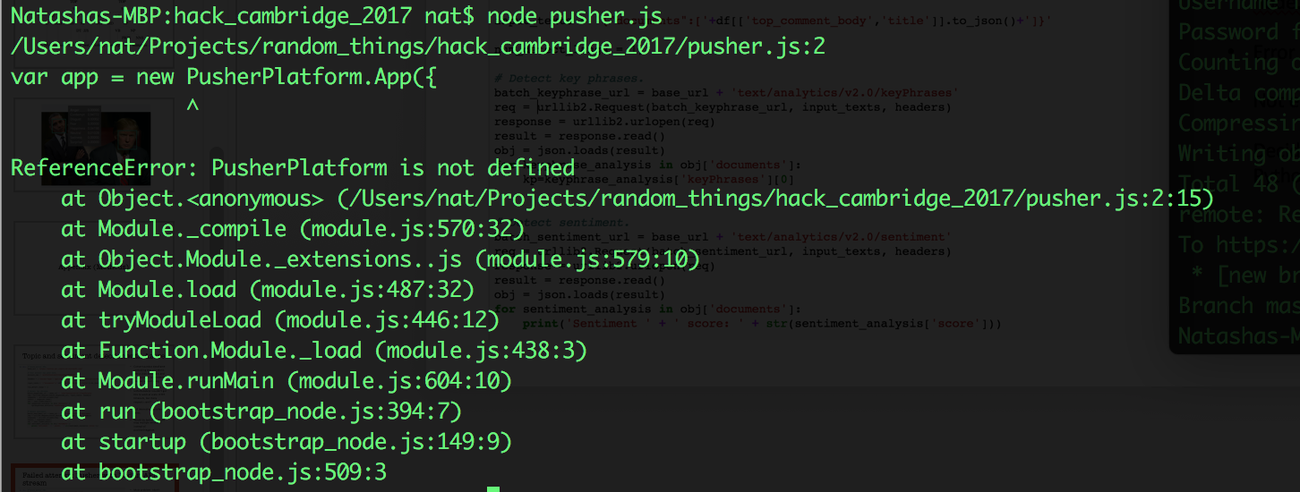
Failed attempt: Pusher with Reddit API stream
Main problem: I don’t know javascript (???)
Installed and tried to use node.js
Error codes a mystery
Not enough time
Decided to just stick to Python and R and data ;P

